Slide 1
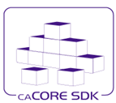
caCORE SDK Code Generator
Satish Patel

Slide 2
Agenda
caCORE SDK requirements
What is caCORE SDK
What is Data Service
System generation process
Generated system architecture
Security overview

Slide 3
What is Required to Use SDK
Must have working knowledge of
UML class diagrams
Enterprise Architect or ArgoUML
Java
Nice to have knowledge about
Hibernate
Web applications
XML

Slide 4
Required Software
UML Modeling Tool (ArgoUML or Enterprise Architect)
Application Server (JBoss or Tomcat)
Java Development Kit – JDK 1.5
Apache Ant
Internet Explorer
and caCORE SDK

Slide 5
What is caCORE SDK
Framework to generate Data Services
Simple tool to build application for collaborative research environment
Enables users to quickly build the APIs from UML Model
Syntactically interoperable APIs (Query via information model
Integrated security
Built using open source tools and technologies
Seamless integration with cagrid tools

Slide 6
Data Service – What Is It?
A service that allows data owners to share the data from source like relational database (e.g. oracle) with their collaborators
caCORE SDK Generated System
OR
Custom Built Application
Human readable interface (GUI)
Database
Machine readable interface (Java API / Webservice)

Slide 7

Data service creation with caCORE SDK

Slide 8
System Generation Process
UML Modeling Tool
Build UML Model
Export UML Model
caCORE SDK Runtime System
Use Generated System
Retrieve Data for User Query
Package Generated Artifacts with Runtime System
Generate Artifacts
Read UML Model
caCORE SDK Code Generation

Slide 9
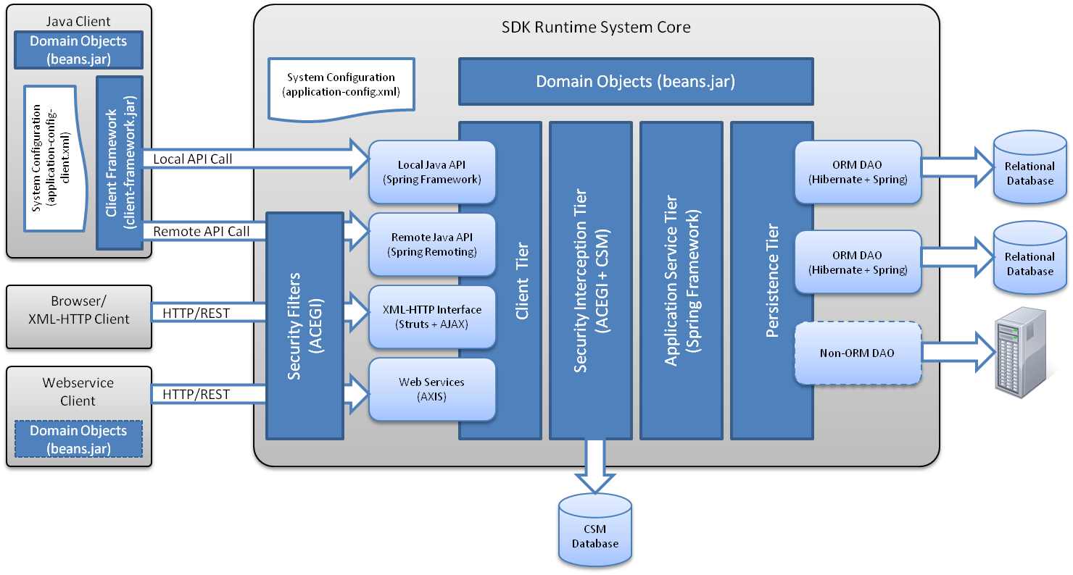
caCORE SDK Architecture

Slide 10
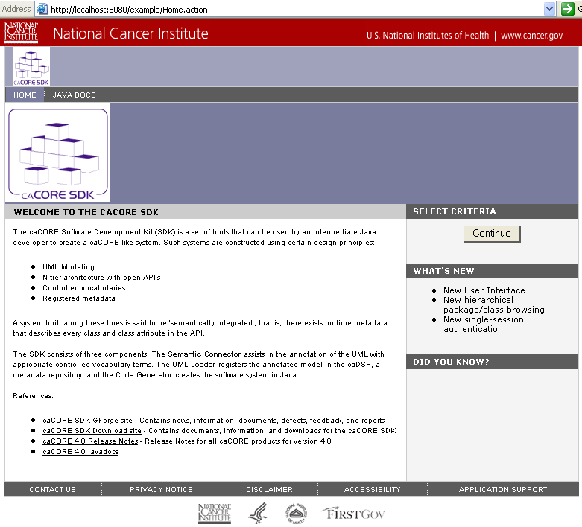
SDK Generated System – HTTP Interface

Slide 11
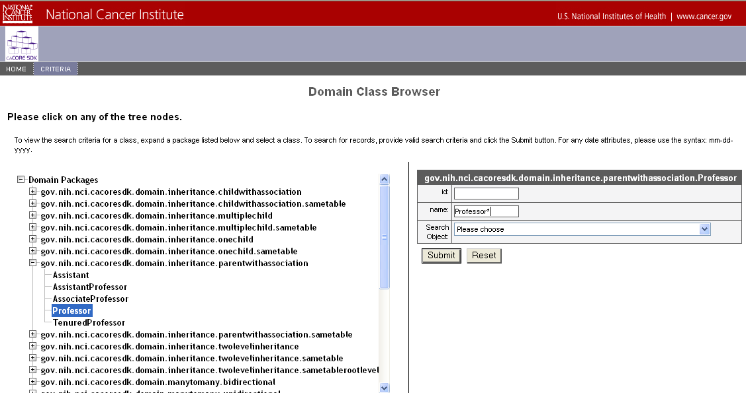
SDK Generated System – HTTP Interface

Slide 12
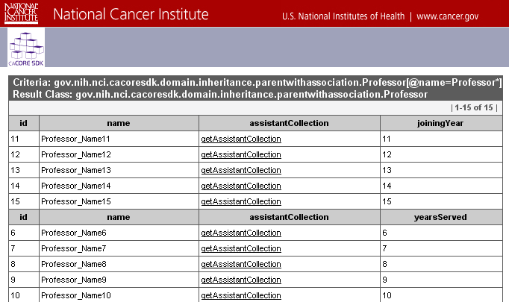
SDK Generated System – HTTP Interface

Slide 13
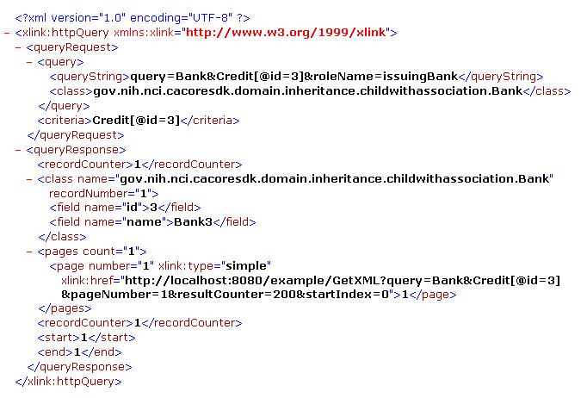
SDK Generated System – XML Interface

Slide 14
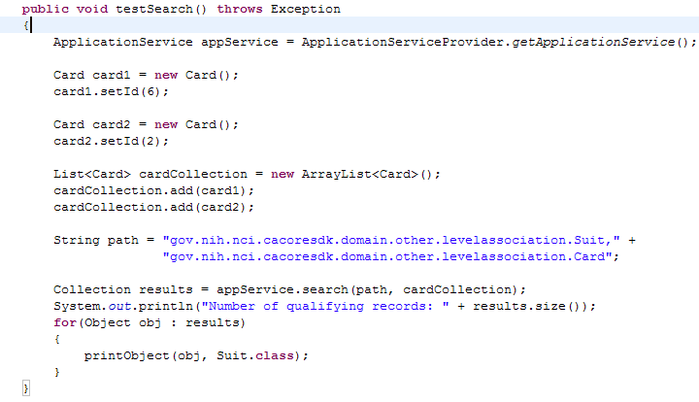
SDK Generated System – Java API

Slide 15
caCORE SDK Security Overview
Common Security Module (CSM) is used for securing SDK
Provides various mechanisms for authentication
RDBMS
LDAP
JAAS
User Provisioning Tool (UPT)
Web based application to configure authorization schema for security

Slide 16
caCORE SDK Security Overview
Three levels of security provided
Class level security
E.g. Only investigators can look at data in Patient class
Instance level security
E.g. Investigators can look at only their patient’s data
Attribute level security
E.g. Nurses can not see patient’s social security number

Slide 17
Example of SDK Generated Applications
Clinical Trials
C3PR
CTOM
CACTUS
Genomics
caArray
caBIO
caIntegrator
Tisue Banking
caTissue CORE
Imaging
NCIA
Infrastructure
EVS
caDSR
UML Project

Slide 18
Questions ???
SDK Users Mailing List
cacore_sdk_users-L@list.nih.gov

Slide 19
Running the Code Generator
Create Object Model (Enterprise Architect)
Create Data Model (Enterprise Architect)
Perform Object to Table mapping (caAdapter)
Perform Attribute to Column mapping (caAdapter)
Import the model (Enterprise Architect)
Re-export the model in XMI format
Configure the code generator
Run the code generator
Run generated system
Note: Steps 3 to 5 can be performed in Enterprise Architect without using caAdapter.
Assumption: Database is already configured and tables are populated with data

Slide 20
Step 1: Creating Object Model (Enterprise Architect)
Define classes and its attributes
Define associations between classes
Always follow naming conventions mentioned in programmer’s guide

Slide 21
Step 2: Creating Data Model (Enterprise Architect)
Define tables and its columns
Define primary key and foreign key constraints

Slide 22
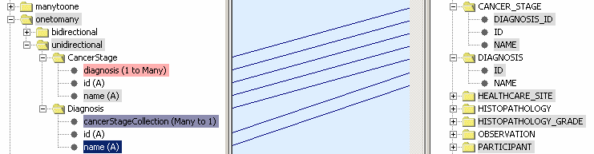
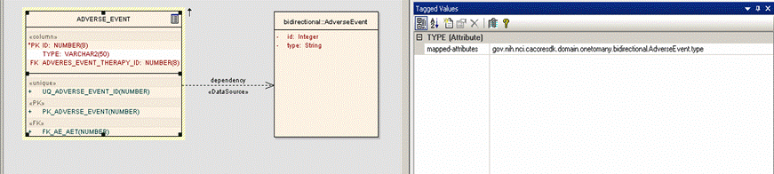
Step 3: Perform Class to Table Mapping (caAdapter or Enterprise Architect)
Create Dependency link between a Class and a Table

Slide 23
Step 4: Perform Attribute to Column Mapping (caAdapter or Enterprise Architect)
Create link between a class attribute and table column using a Tag Value

Slide 24
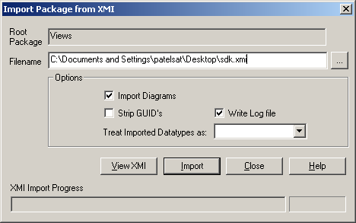
Step 5: Import UML Model (Enterprise Architect)
Import model modified by caAdapter in Enterprise Architect

Slide 25
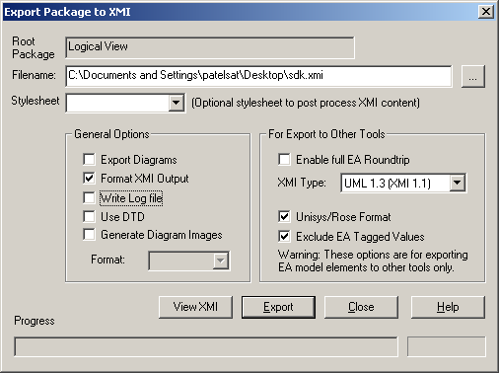
Step 6: Re-export UML Model (Enterprise Architect)
Export model modified from Enterprise Architect using code generator specific export options

Slide 26
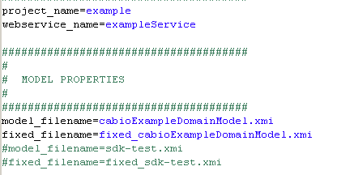
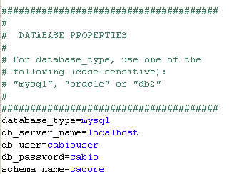
Step 7: Configure Code Generator
Configuration defined in deploy.properties

Slide 27
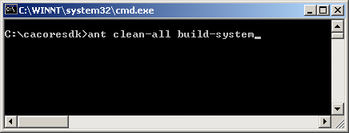
Step 8: Run Code Generator
Put exported XMI file in caCORE SDK’s models/xmi directory
Go to command window
Execute build-system target

Slide 28
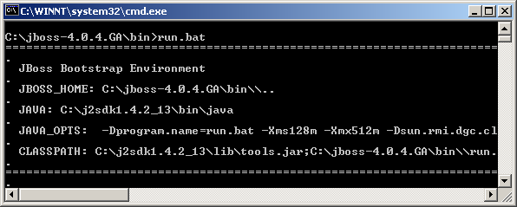
Step 9: Running Generated System
Start application server

Slide 29
Questions ???
SDK Users Mailing List
cacore_sdk_users-L@list.nih.gov

Slide 30
caCORE Process
Design system and draw model (UML tool)
Annotate model (Semantic Connector)
Register metadata (UML Loader)
Generate and deploy system (Code Generator)

